Slide 1
“FULL” FLAX
KV3
(Hiếu – Nam – Long)

Slide 2
Outline
1. Introduction
2. Layout – OCR
3. Graph Key-Value
4. GNN Explainer
5. Demo

Slide 3
Introduction

Slide 4
FULLFLAX

Slide 5
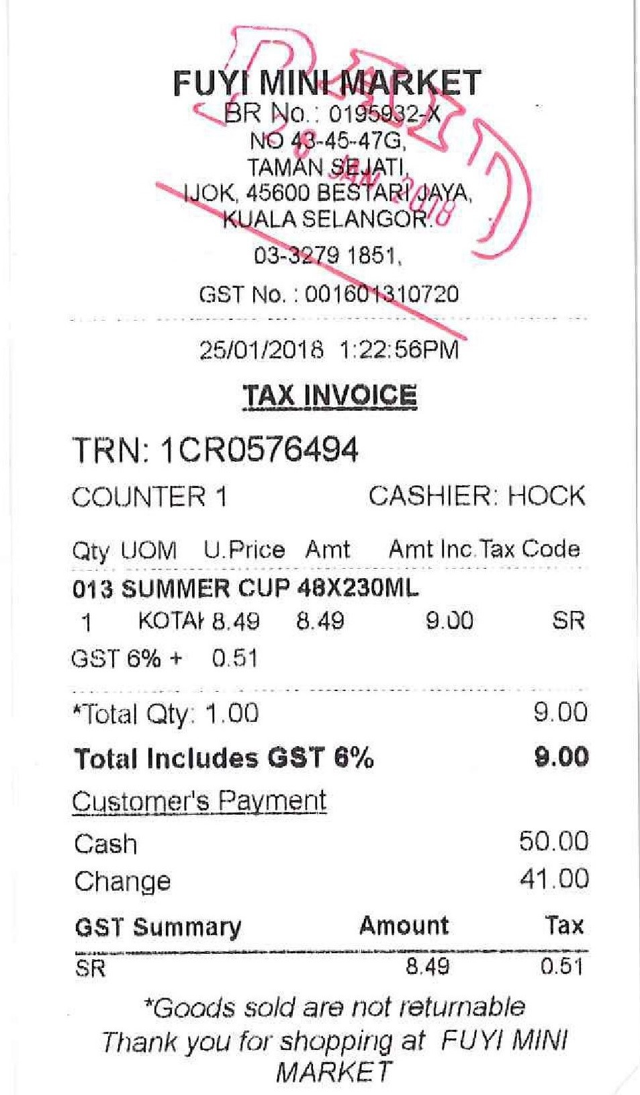
FULLFLAX
IMPORTANT
INFORMATION
EXPLANATION

Slide 6
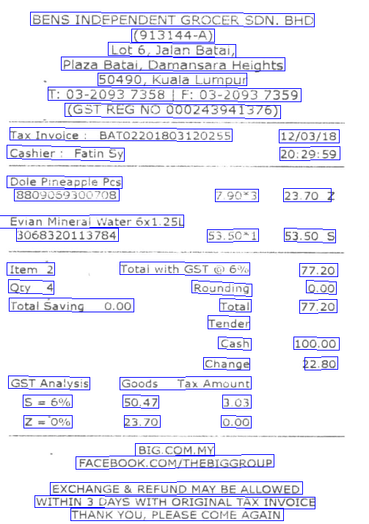
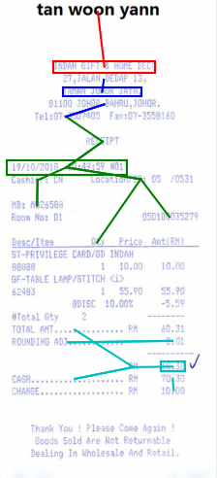
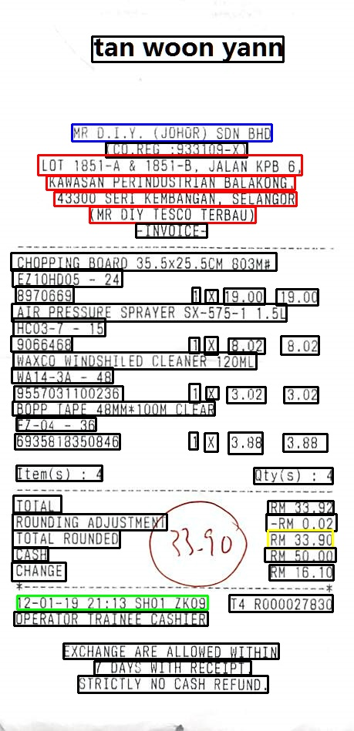
LAYOUT
OCR
TEXT VALUES
GRAPH KV
GNN Explainer

Slide 7
Introduction
TA DA
LAYOUT
Nam
OCR
FULLFLAX
Hiếu
Long
GRAPH KV
Long
GNN Explainer

Slide 8
Layout - OCR

Slide 9
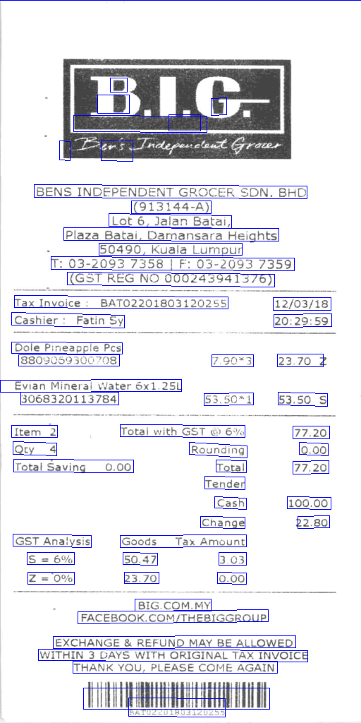

Slide 10
Graph Key-Value

Slide 11
The Problem
UNKNOWN
DATE
TOTAL
ADDRESS
COMPANY
N x F
L x N x N
N x C

Slide 12
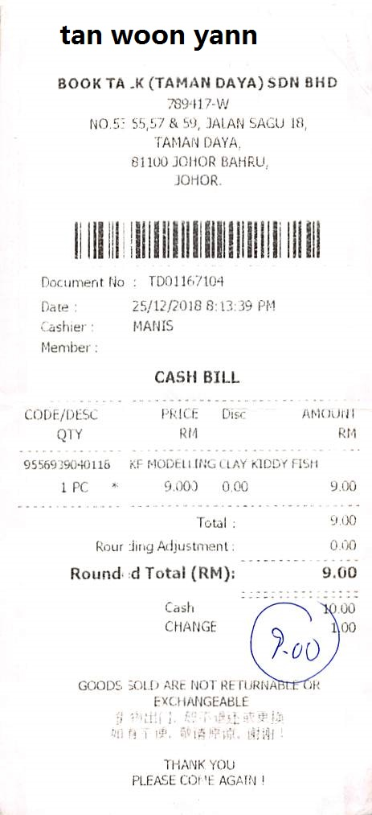
Review on Spatial Graph and problems on encoding
Missing number information
Encode Vertex BoW without losing numbers information
75 %

Slide 13
Baseline structure
(128, 512)
(512, 1024, 4)
(1024, 512, 4)
(512, 128, 4)
[V, A]
(600, 128)
Conv
Conv
Conv
Conv
INPUT
LINEAR
LINEAR
(128, 512)
(N x C)
(128, 4)
(512, 128, 4)
(1024, 512, 4)
(512, 1024, 4)
Conv
Conv
Conv
OUTPUT
LINEAR

Slide 14
METRICS
PROPOSAL
Accuracy: 0.985101 Accuracy 0.982494 Macro F1 : 0.935667 - 585.727286 Micro F1 : 0.982494 - 615.041373
Detect TEXT including numbers
Other encoding methods
NOT BAD
OVERFIT ?

Slide 15
Don’t trust our model? Here comes the magical EXPLAINER

Slide 16
Brief introduction
After GNN prediction
The GNN Explainer
DATE
TOTAL
TOTAL
WHY ?
Graph with classified nodes
COMPANY / ADDRESS / DATE / TOTAL / UNKNOWN
Explanation for each node

Slide 17
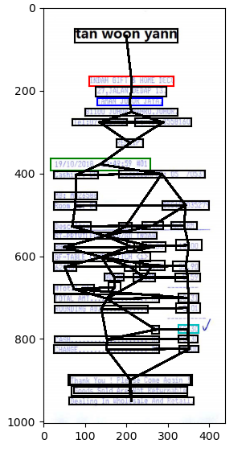
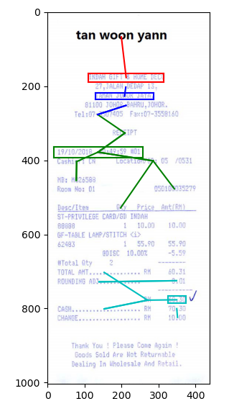
Brief introduction
Graph with classified nodes
COMPANY / ADDRESS / DATE / TOTAL / UNKNOWN
Explanation for each node

Slide 18
How it works
KEY IDEA: What part of the graph contributes the most in the classification of “X”?
Trained Graph KV
x
TOTAL
(Classifying node x)

Slide 19

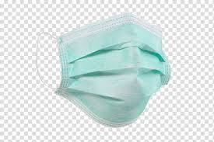

How it works
N x F
L x N x N
Trained Graph KV
INPUT =
OUTPUT = ?
x
x
MASK
x

Slide 20
SUPERVISED LEARNING
TRAINED MODEL
(before testing)
TEST INPUT
TEST OUPUT
(make 1 prediction)
SELF-SUPERVISED LEARNING
TRAINING …
(OPTIMIZING)
(during testing)
TEST INPUT
TEST OUPUT
(make many predictions)
…
x
x
x

Slide 21
Some details in implementation
Presenting graph
K-hop
BFS
x
Adj matrix
(L x N x N)
2 x number of edges
Loss
Mask shape
Edge
= (1 x number of edges)
Predicted loss
Size (sum)
Entropy
(value = [0…1])
Feature
= (1 x number of features)

Slide 22
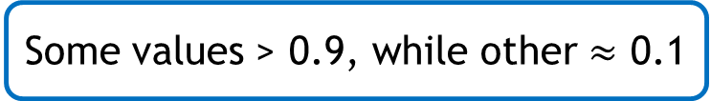
Result
Edge
Feature
Some values > 0.9, while other $≈$ 0.1
Values → → → 0 (stated in the paper)
Reparameterization trick
Fix coefficients in loss funtion
Didn’t work so well

Slide 23
THANK YOU ALL FOR EVERY THING!!! <3

